Slide 1

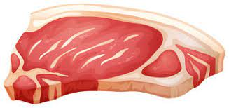
Can pigs benefit from vitamin supplements?
Ethan Scott & Daniel Girvitz
Notes:
So, essentially, we seek to determine if pigs can benefit - quote-on-quote - from vitamin supplements. That is, can we determine if feeding them Vitamin E and Copper will statistically-significantly increase their weights after a fixed time interval.

Slide 2

Data
Weight - Weight in Kg
Feed - Cumulated feed intake in Kg
Time - Time (in weeks) in the experiment
Pig - Factor; id of each pig
Evit - Factor; vitamin E dose
Cu - Factor, copper dose
Start - Start weight in experiment, i.e. weight at week 1.
Litter - Factor, id of litter of each pig
Weight change - change in weight from week 1 to week 11 (week 11 is used as some pigs do not have data for week 12)
Notes:
Data contains weights of 72 slaughter pigs measured weekly for 12 weeks. Data also contains the startweight (i.e. the weight at week 1).
The treatments are 3 different levels of vitamin E (Evit) (dose: 0, 100, 200 mg/kg feed) in combination with 3 different levels of Copper (Cu) (dose: 0, 35, 175 mg/kg feed) in the feed. The cumulative feed intake is also recorded.
Note we had to do a little bit of data cleaning in that we created a new variable, weight change, the change in weight from week 1 to week 11 (week 11 is used as some pigs do not have data for week 12)

Slide 3
Data assumptions
Amount of feed (in kg) eaten by pigs is negligible
Genetic predispositions among individual pigs and between litters is negligible

Slide 4
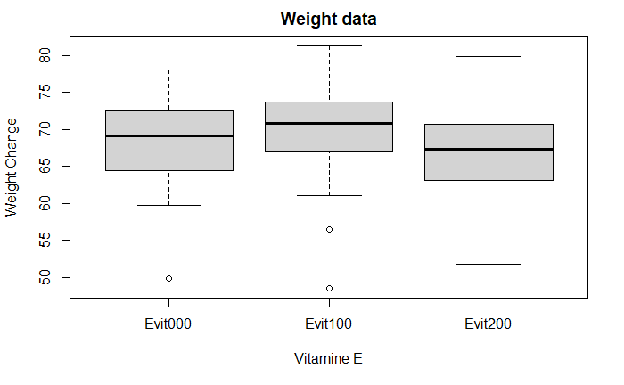
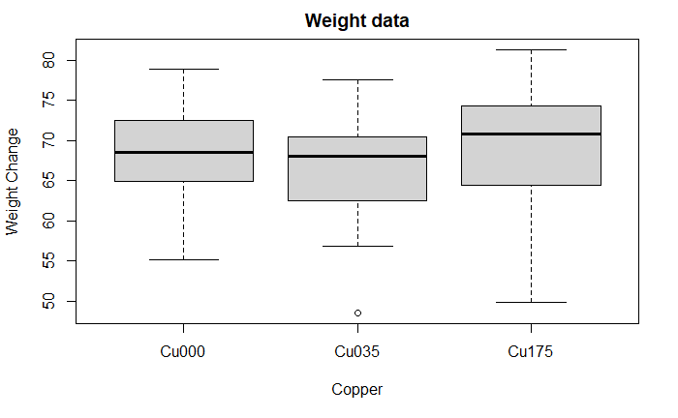
Boxplots
Notes:
Boxplots indicate what appears to be no significant differences among the groups.

Slide 5
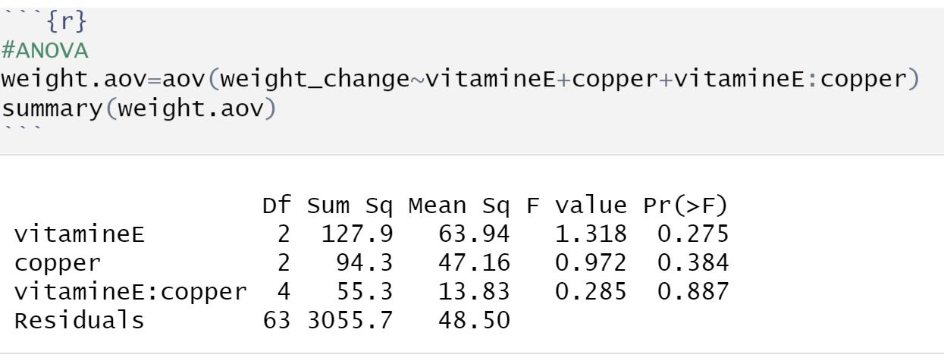
ANOVA
H0: Equality of treatment means
Ha: Inequality of at least one treatment mean
Notes:
We chose to run a two-factor factorial design
vitamin E, copper – treatments

Slide 6
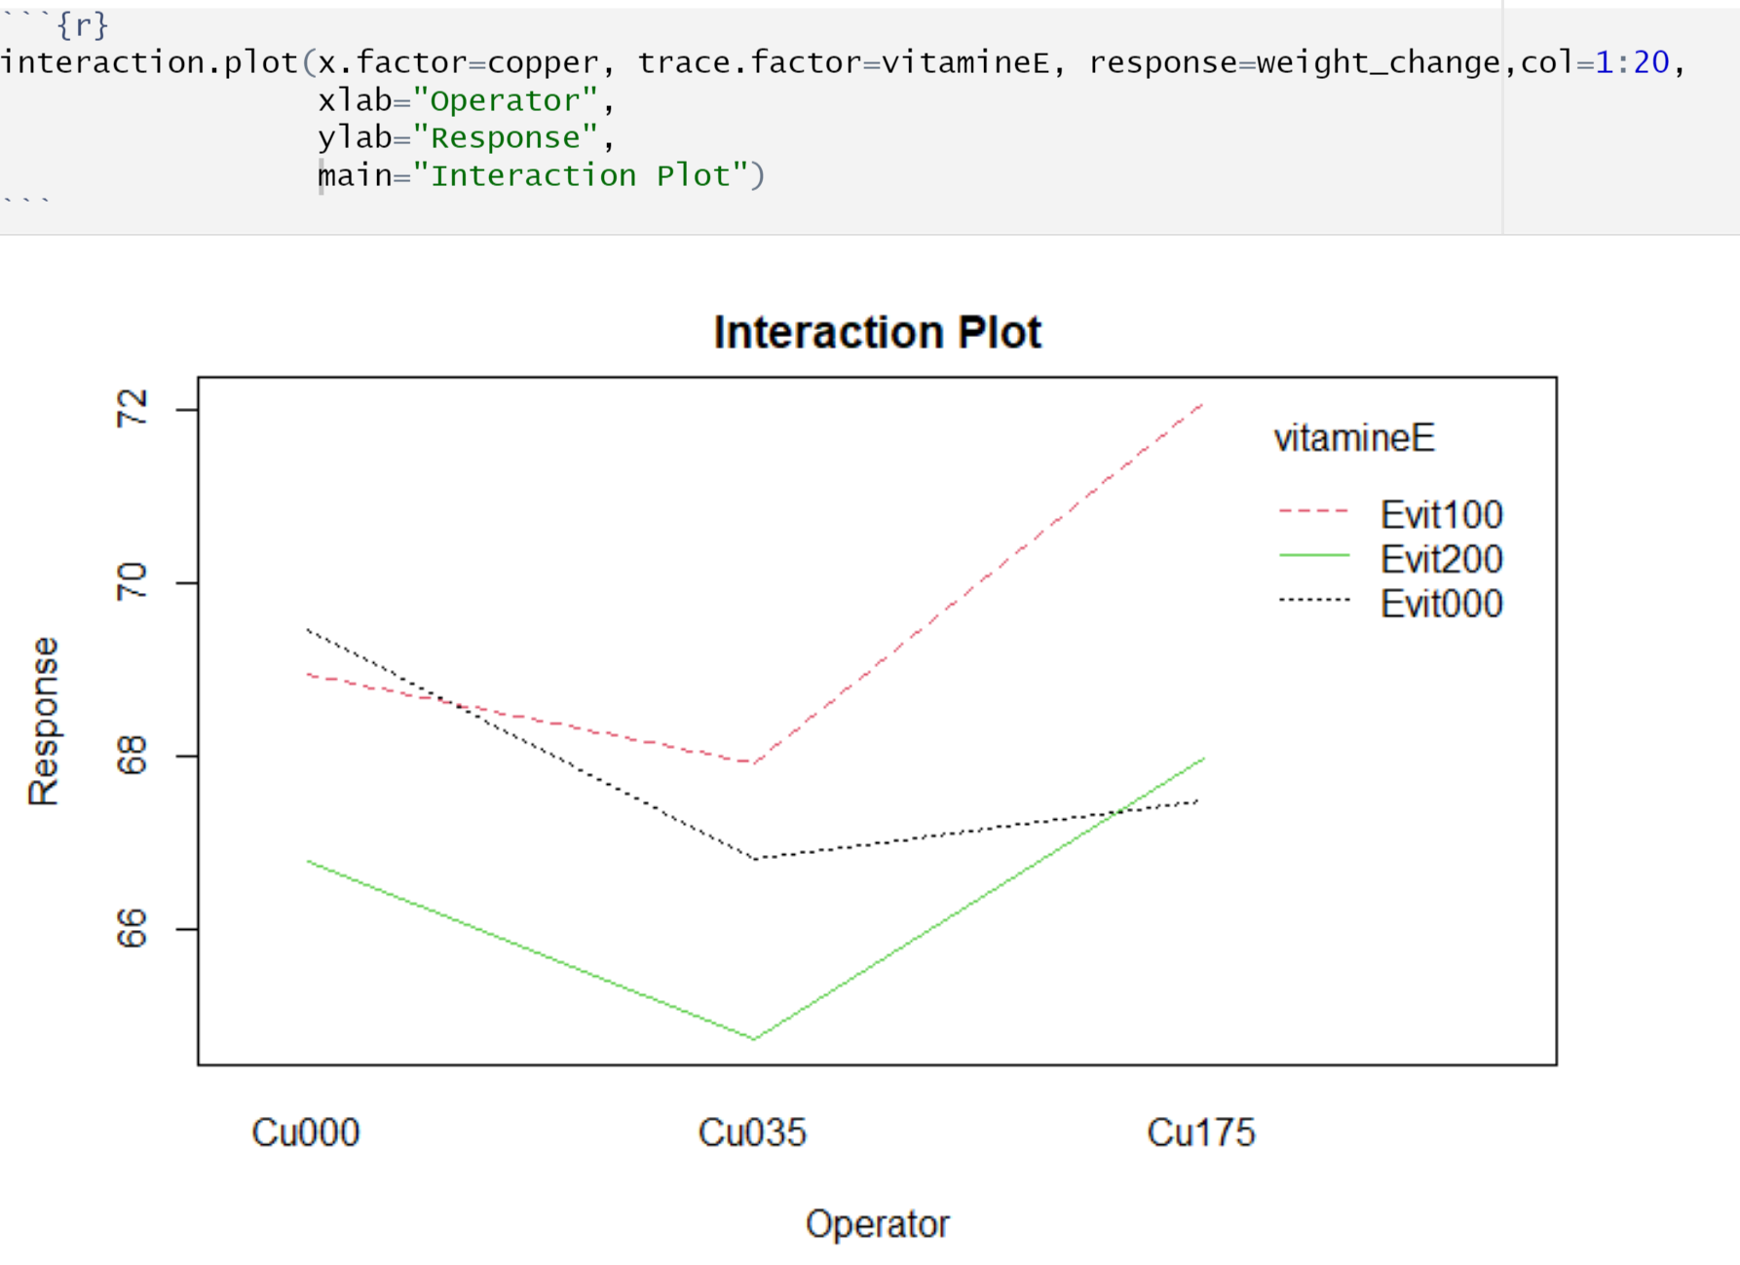
Interactions
Notes:
As the lines cross, we assume there is interaction

Slide 7
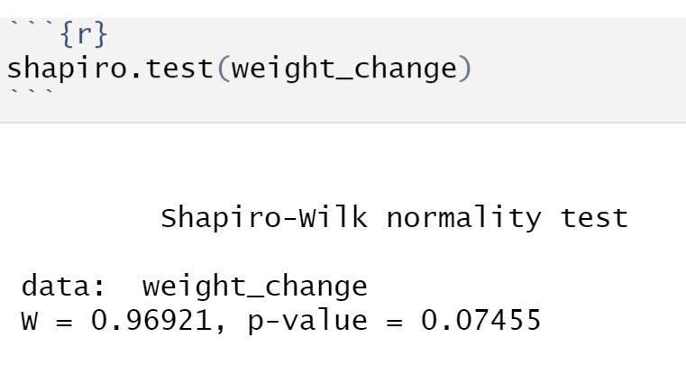
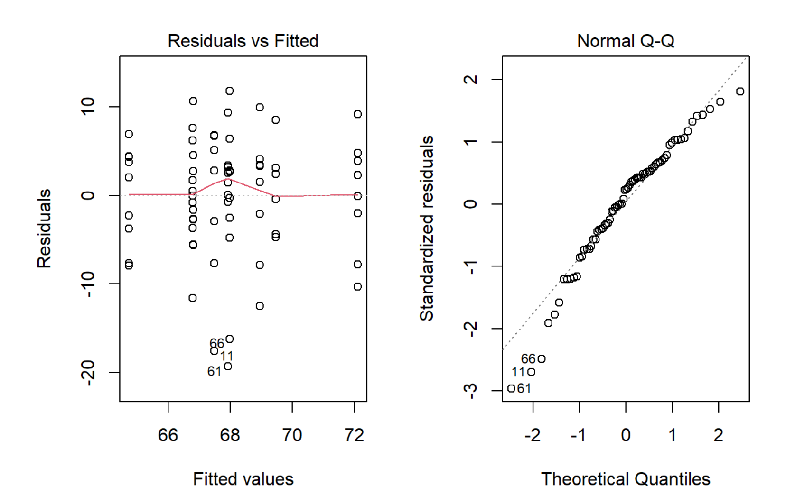
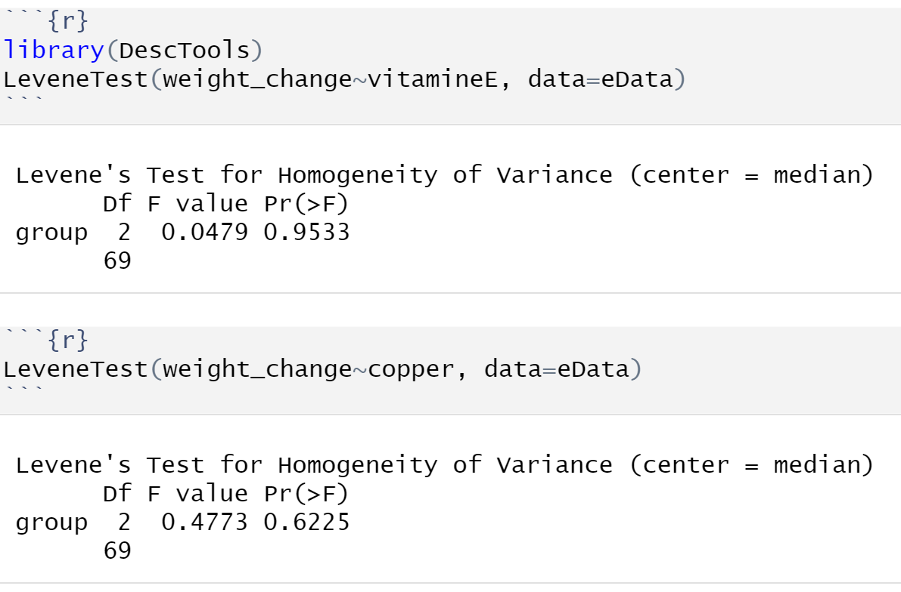
Diagnostic Plots
Notes:
From our two plots we can see that most likely our assumptions hold
Residuals vs fitted: Residuals distributed randomly with no increase or decrease in width along the horizontal
Normal QQ: points fit diagonal, which crosses origin, pretty well, which indicates normality should hold
The numerical tests show data is normally distributed and we have equal variances
Shapiro-Wilk test: As pvalue of 0.07 > 0.05, we FTR normality assumption
LeveneTests: As both pvalues > 0.05, we FTR equal variance assumption

Slide 8
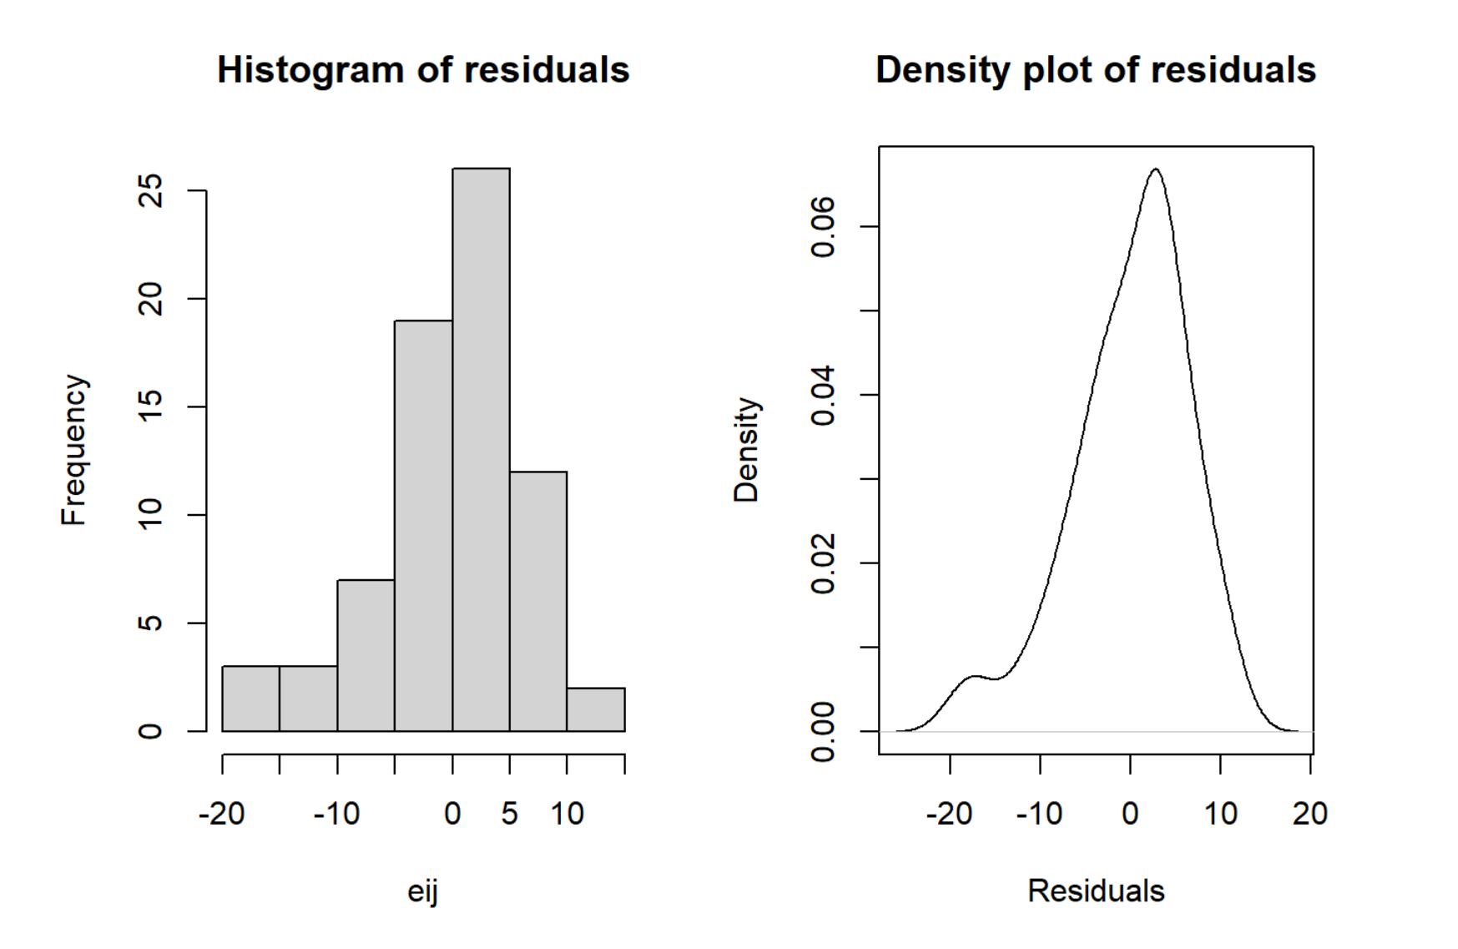
Residuals
Notes:
Graphs indicate a minor left skew,
but
From shapiro-wilk test we can see that our residuals are normally distributed

Slide 9
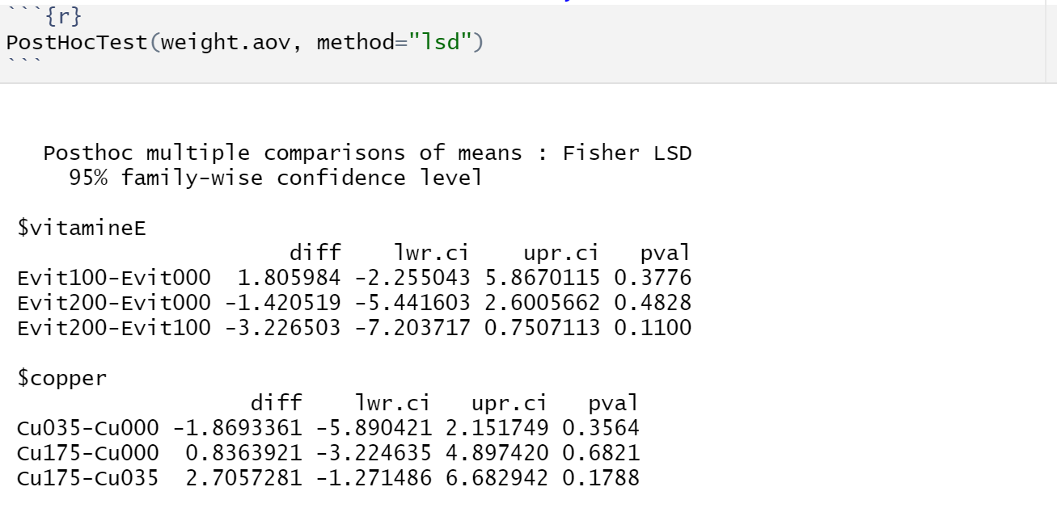
Fisher LSD Test
Notes:
All p-values are above 0.05 so we can conclude that there is no significant difference in treatment means. This confirms our ANOVA results

Slide 10
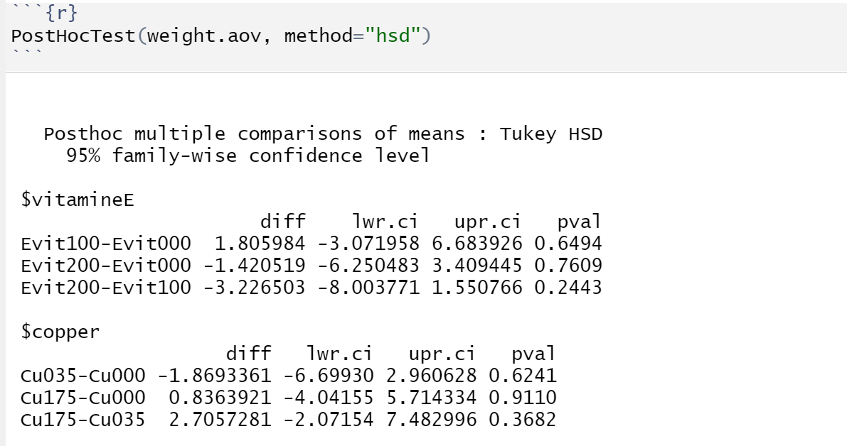
Tukey HSD Test
Notes:
All p-values are above 0.05 so we can conclude that there is no significant difference in treatment means. This confirms our ANOVA results

Slide 11
Conclusion
We can conclude that there is no significant difference in weight change of the pigs due to the intake of Vitamin E or Copper. In STAT 425 terms, we FTR the null hypothesis (H0) of equality of treatment means.

